Slide 1
INTRODUCTION TO BOOSTING
https://cse.iitk.ac.in/users/piyush/courses/ml_autumn16/771A_lec21_slides.pdf
https://ocw.mit.edu/courses/sloan-school-of-management/15-097-prediction-machine-learning-and-statistics-spring-2012/lecture-notes/MIT15_097S12_lec10.pdf
https://www.cs.toronto.edu/~hinton/csc2515/notes/lec11boo.htm
http://www.ccs.neu.edu/home/vip/teach/MLcourse/4_boosting/slides/gradient_boosting.pdf
http://blog.kaggle.com/2017/01/23/a-kaggle-master-explains-gradient-boosting/
https://www.analyticsvidhya.com/blog/2018/09/an-end-to-end-guide-to-understand-the-math-behind-xgboost/

Slide 2
DEFINITION
The term ‘Boosting’ refers to a family of algorithms which converts weak learner to strong learners.
Let’s understand this definition in detail by solving a problem of spam email identification:
How would you classify an email as SPAM or not? Like everyone else, our initial approach would be to identify ‘spam’ and ‘not spam’ emails using following criteria. If:
  Email has only one image file (promotional image), It’s a SPAM
  Email has only link(s), It’s a SPAM
  Email body consist of sentence like “You won a prize money of $ xxxxxx”, It’s a SPAM
  Email from our official domain “metu.edu.tr” , Not a SPAM
  Email from known source, Not a SPAM
Above, we’ve defined multiple rules to classify an email into ‘spam’ or ‘not spam’. But, do you think these rules individually are strong enough to successfully classify an email? No.
Individually, these rules are not powerful enough to classify an email into ‘spam’ or ‘not spam’. Therefore, these rules are called as weak learner.

Slide 3
DEFINITION
To convert weak learner to strong learner, we’ll combine the prediction of each weak learner using methods like:
• Using average/ weighted average
• Considering prediction has higher vote
For example: Above, we have defined 5 weak learners. Out of these 5, 3 are voted as ‘SPAM’ and 2 are voted as ‘Not a SPAM’. In this case, by default, we’ll consider an email as SPAM because we have higher(3) vote for ‘SPAM’.

Slide 4
How Boosting Algorithms works?
To find weak rule, we apply base learning algorithms with a different distribution. Each time base learning algorithm is applied, it generates a new weak prediction rule. This is an iterative process. After many iterations, the boosting algorithm combines these weak rules into a single strong prediction rule.
For choosing the right distribution, here are the following steps:
  Step 1: The base learner takes all the distributions and assign equal weight or attention to each observation.
  Step 2: If there is any prediction error caused by first base learning algorithm, then we pay higher attention to observations having prediction error. Then, we apply the next base learning algorithm.
  Step 3: Iterate Step 2 till the limit of base learning algorithm is reached or higher accuracy is achieved.
Finally, it combines the outputs from weak learner and creates a strong learner which eventually improves the prediction power of the model. Boosting pays higher focus on examples which are misclassiﬁed or have higher errors by preceding weak rules.

Slide 5
Types of Boosting Algorithms
Underlying engine used for boosting algorithms can be anything. It can be decision stamp, margin-maximizing classification algorithm etc. There are many boosting algorithms which use other types of engine such as:
  AdaBoost (Adaptive Boosting)
  Gradient Tree Boosting
  GentleBoost
  LPBoost
  BrownBoost
  XGBoost
  CatBoost
  Lightgbm

Slide 6
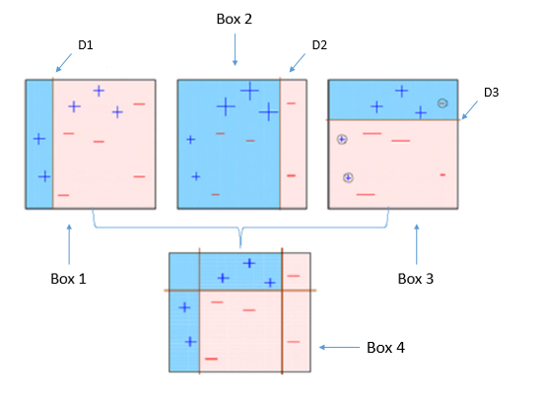
AdaBoost
Box 1: You can see that we have assigned equal weights to each data point and applied a decision stump to classify them as + (plus) or – (minus). The decision stump (D1) has generated vertical line at left side to classify the data points. We see that, this vertical line has incorrectly predicted three + (plus) as – (minus). In such case, we’ll assign higher weights to these three + (plus) and apply another decision stump.

Slide 7
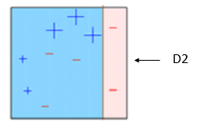
AdaBoost
Box 2: Here, you can see that the size of three incorrectly predicted + (plus) is bigger as compared to rest of the data points. In this case, the second decision stump (D2) will try to predict them correctly. Now, a vertical line (D2) at right side of this box has classified three misclassified + (plus) correctly. But again, it has caused misclassification errors. This time with three -(minus). Again, we will assign higher weight to three – (minus) and apply another decision stump.

Slide 8
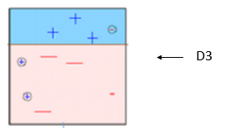
Adaboost
Box 3: Here, three – (minus) are given higher weights. A decision stump (D3) is applied to predict these misclassified observation correctly. This time a horizontal line is generated to classify + (plus) and – (minus) based on higher weight of misclassified observation.

Slide 9
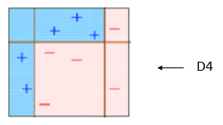
Adaboost
Box 4: Here, we have combined D1, D2 and D3 to form a strong prediction having complex rule as compared to individual weak learner. You can see that this algorithm has classified these observation quite well as compared to any of individual weak learner.

Slide 10
AdaBoost (Adaptive Boosting)
It works on similar method as discussed above. It fits a sequence of weak learners on different weighted training data. It starts by predicting original data set and gives equal weight to each observation. If prediction is incorrect using the first learner, then it gives higher weight to observation which have been predicted incorrectly. Being an iterative process, it continues to add learner(s) until a limit is reached in the number of models or accuracy.
Mostly, we use decision stamps with AdaBoost. But, we can use any machine learning algorithms as base learner if it accepts weight on training data set. We can use AdaBoost algorithms for both classification and regression problem.

Slide 11
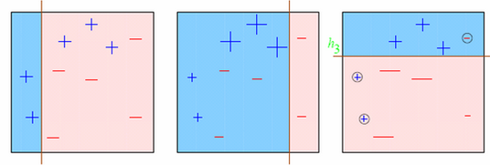
Let’s try to visualize one Classification Problem
Look at the below diagram :
We start with the first box. We see one vertical line which becomes our first week learner. Now in total we have 3/10 mis-classified observations. We now start giving higher weights to 3 plus mis-classified observations. Now, it becomes very important to classify them right. Hence, the vertical line towards right edge. We repeat this process and then combine each of the learner in appropriate weights.

Slide 12


Explaining underlying mathematics
How do we assign weight to observations?
We always start with a uniform distribution assumption. Lets call it as D₁ which is 1/n for all n observations.
Step 1 . We assume an alpha(t)
Step 2: Get a weak classifier h(t)
Step 3: Update the population distribution for the next step
where

Slide 13

Explaining underlying mathematics
Simply look at the argument in exponent. Alpha is kind of learning rate, y is the actual response ( + 1 or -1) and h(x) will be the class predicted by learner. Essentially, if learner is going wrong, the exponent becomes 1*alpha and else -1*alpha. The weight will probably increase, if the prediction went wrong the last time.
Step 4 : Use the new population distribution to again find the next learner
Step 5 : Iterate step 1 – step 4 until no hypothesis is found which can improve further.
Step 6 : Take a weighted average of the frontier using all the learners used till now. But what are the weights? Weights are simply the alpha values. Alpha is calculated as follows:

Slide 14
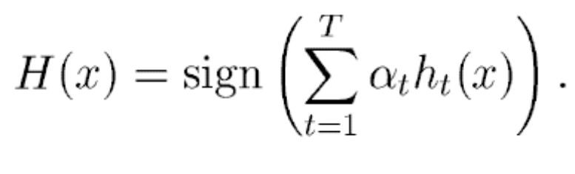
Explaining underlying mathematics
Output the final hypothesis

Slide 15
Gradient Boosting
In gradient boosting, it trains many models sequentially. Each new model gradually minimizes the loss function (y = ax + b + e, e needs special attention as it is an error term) of the whole system using Gradient Descent method. The learning procedure consecutively fit new models to provide a more accurate estimate of the response variable.
The principle idea behind this algorithm is to construct new base learners which can be maximally correlated with negative gradient of the loss function, associated with the whole ensemble.

Slide 16
Gradient Boosting
Type of Problem – You have a set of variables vectors x1 , x2 and x3. You need to predict y which is a continuous variable.
Steps of Gradient Boost algorithm
  Step 1 : Assume mean is the prediction of all variables.
  Step 2 : Calculate errors of each observation from the mean (latest prediction).
  Step 3 : Find the variable that can split the errors perfectly and find the value for the split. This is assumed to be the latest prediction.
  Step 4 : Calculate errors of each observation from the mean of both the sides of split (latest prediction).
  Step 5 : Repeat the step 3 and 4 till the objective function maximizes/minimizes.
  Step 6 : Take a weighted mean of all the classifiers to come up with the final model.

Slide 17
Example
Assume, you are given a previous model M to improve on. Currently you observe that the model has an accuracy of 80% (any metric). How do you go further about it?
One simple way is to build an entirely different model using new set of input variables and trying better ensemble learners. On the contrary, I have a much simpler way to suggest. It goes like this:
Y = M(x) + error
What if I am able to see that error is not a white noise but have same correlation with outcome(Y) value. What if we can develop a model on this error term? Like,
error = G(x) + error2

Slide 18
Example
Probably, you’ll see error rate will improve to a higher number, say 84%. Let’s take another step and regress against error2.
error2 = H(x) + error3
Now we combine all these together :
Y = M(x) + G(x) + H(x) + error3
This probably will have an accuracy of even more than 84%. What if I can find an optimal weights for each of the three learners,
Y = alpha * M(x) + beta * G(x) + gamma * H(x) + error4

Slide 19
Example
If we found good weights, we probably have made even a better model. This is the underlying principle of a boosting learner.
Boosting is generally done on weak learners, which do not have a capacity to leave behind white noise.
Boosting can lead to overfitting, so we need to stop at the right point.

Slide 20
How to improve regression results
You are given (x₁, y₁), (x₂, y₂), …, (x_{n}, y_{n}), and the task is to t a model F(x) to minimize square loss.
Suppose your friend wants to help you and gives you a model F.
You check his model and find the model is good but not perfect. There are some mistakes: F(x₁) = 0.8, while y₁ = 0.9, and F(x₂) = 1.4 while y₂ = 1.3. How can you improve this model?
Rule of the game:
  You are not allowed to remove anything from F or change any parameter in F.
  You can add an additional model (regression tree) h to F, so
  the new prediction will be F(x) + h(x).

Slide 21
Simple solution:
You wish to improve the model such that
F(x₁) + h(x₁) = y₁
F(x₂) + h(x₂) = y₂
:::
F(x_{n}) + h(x_{n}) = y_{n}
Or, equivalently, you wish
h(x₁) = y₁ ̶ F(x₁)
h(x₂) = y₂ ̶ F(x₂)
:::
h(x_{n}) = y_{n} ̶ F(x_{n})
Can any regression tree h achieve this goal perfectly?

Slide 22
Maybe not....
But some regression tree might be able to do this approximately.
How?
Just fit a regression tree h to data
(x₁, y₁ ̶ F(x₁)), (x₂, y₂ ̶ F(x₂)), …, (x_{n}, y_{n} ̶ F(x_{n}))
Congratulations, you get a better model!
y_{i} ̶ F(x_{i}) are residuals. These are the parts that existing model F cannot do well.
The role of h is to compensate the shortcoming of existing model F. If the new model F + h is still not satisfactory, we can add another regression tree...
We are improving the predictions of training data, but is the procedure also useful for test data?
Yes! Because we are building a model, and the model can be applied to test data as well.
How is this related to gradient descent?

Slide 23
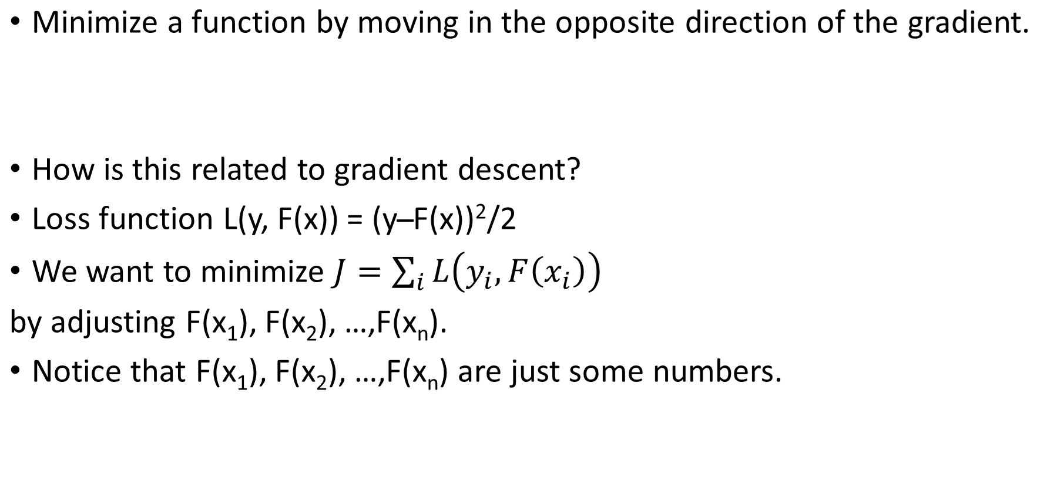
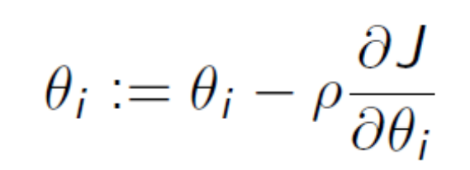
Gradient Descent

Slide 24
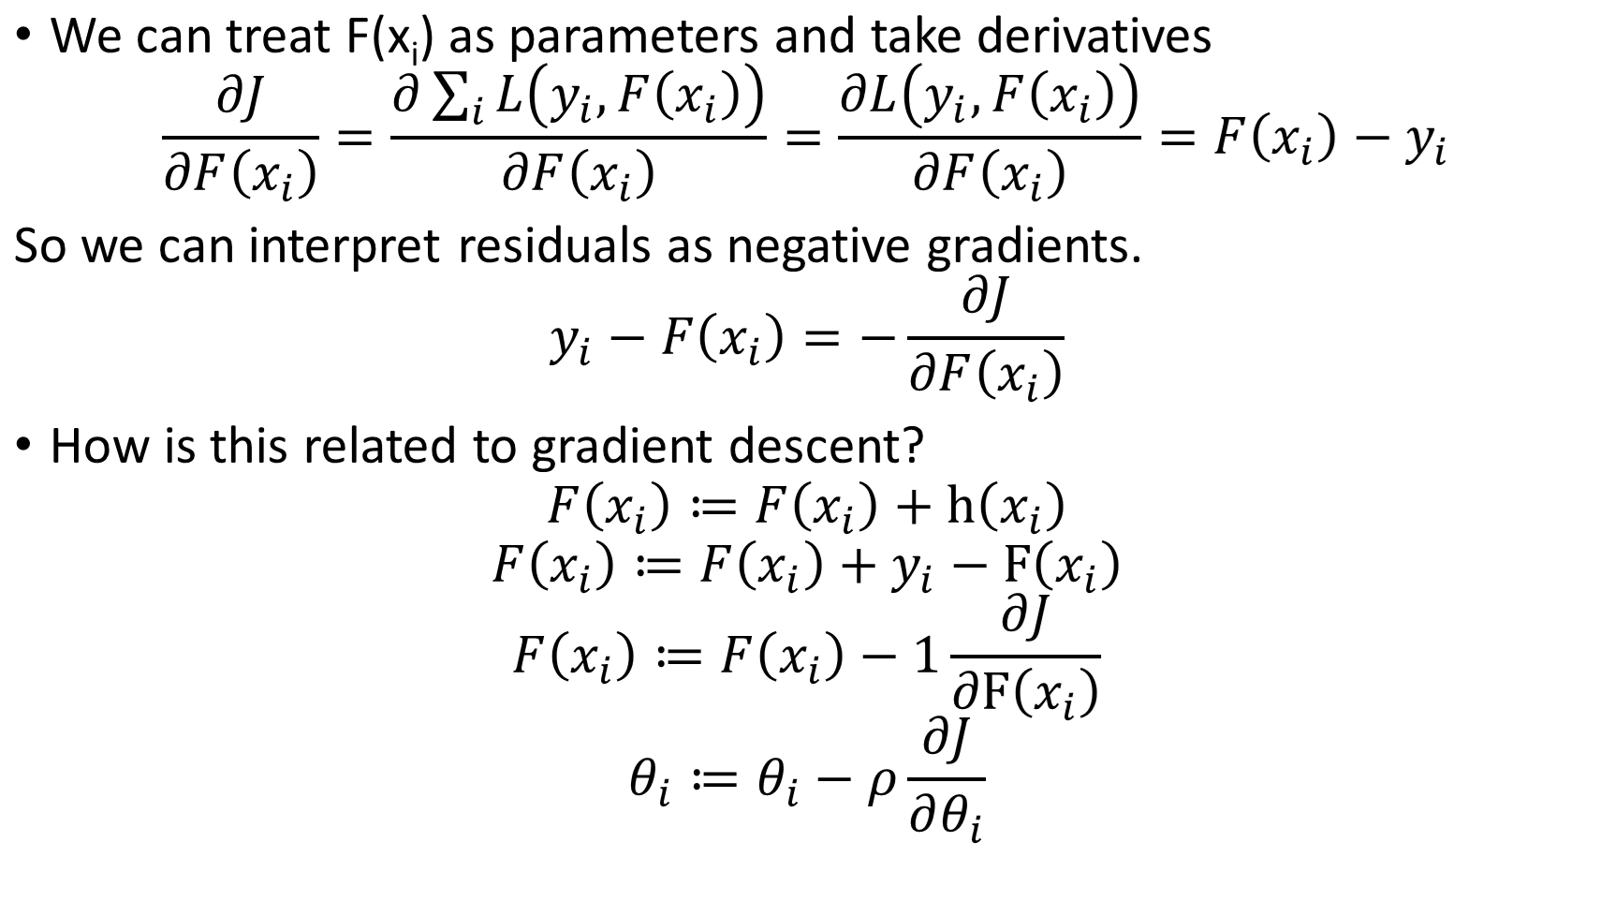

Slide 25
How is this related to gradient descent?
For regression with square loss,
residual ⇔ negative gradient
fit h to residual ⇔ fit h to negative gradient
update F based on residual ⇔ update F based on negative gradient
So we are actually updating our model using gradient descent! It turns out that the concept of gradients is more general and useful than the concept of residuals. So from now on, let's stick with gradients.

Slide 26
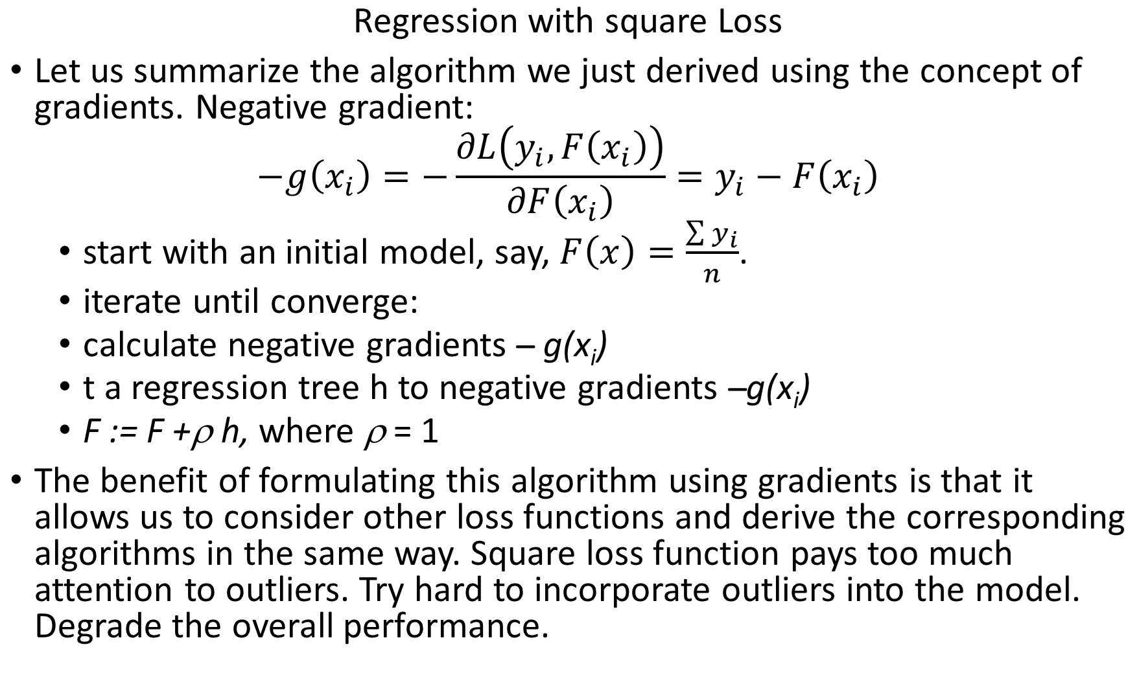

Slide 27
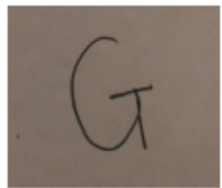
Problem
Recognize the given hand written capital letter.
  Multi-class classification
  26 classes. A,B,C,...,Z
Data Set
http://archive.ics.uci.edu/ml/datasets/Letter+Recognition
20000 data points, 16 features

Slide 28
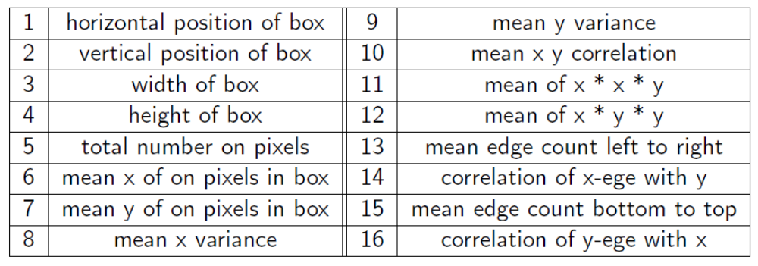
Feature Extraction
Feature Vector= (2, 1, 3, 1, 1, 8, 6, 6, 6, 6, 5, 9, 1, 7, 5, 10)
Label = G

Slide 29
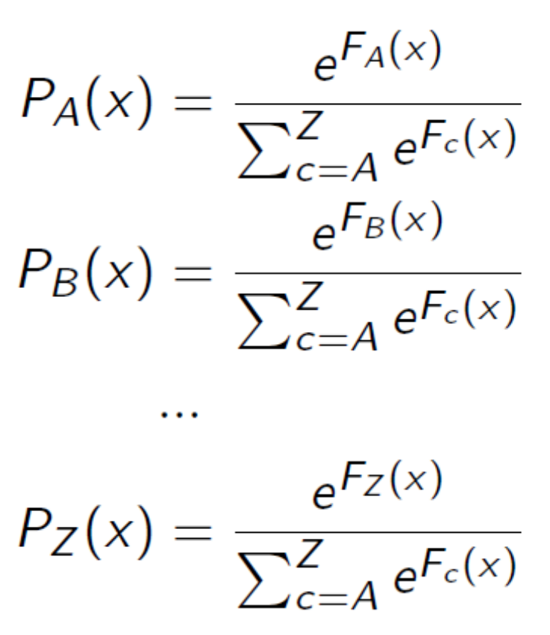
Model
26 score functions (our models): F_{A}, F_{B}, F_{C} , …, F_{Z} .
F_{A}(x) assigns a score for class A
scores are used to calculate probabilities
predicted label = class that has the highest probability

Slide 30
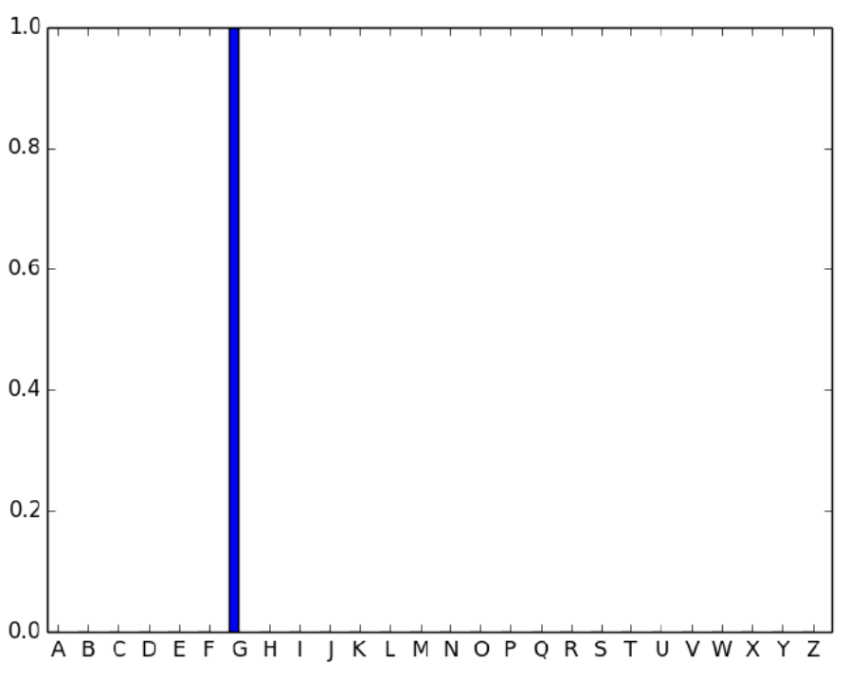
Loss Function for each data point
Step 1. turn the label y_{i} into a (true) probability distribution Y_{c} (x_{i}). For example: y₅=G, Y_{A}(x₅) = 0, Y_{B}(x₅) = 0, …, Y_{G} (x₅) = 1, …, Y_{Z} (x₅) = 0.

Slide 31
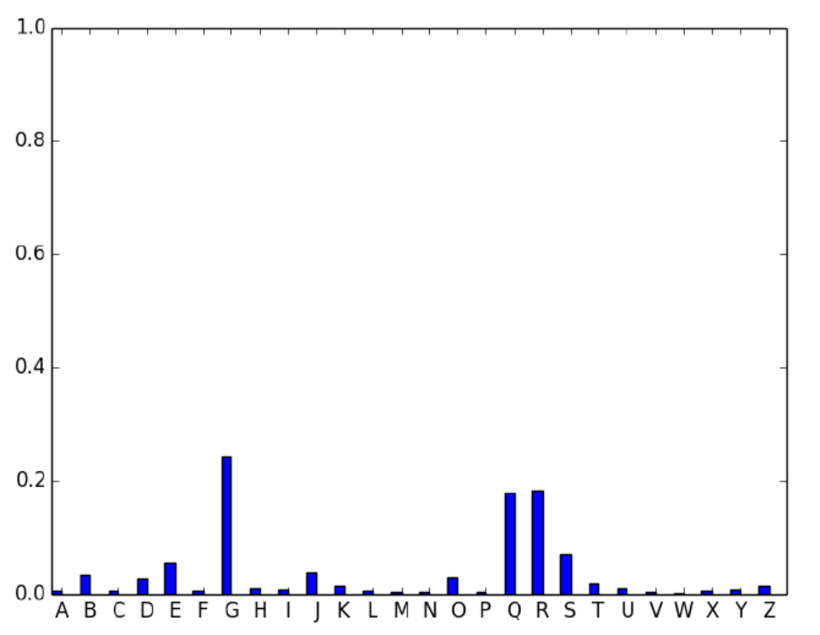
Step 2. Calculate the predicted probability distribution P_{c}(x_{i}) based on the current model F_{A}, F_{B}, …, F_{Z} . P_{A}(x₅) = 0.03, P_{B}(x₅) = 0.05, …, P_{G} (x₅) = 0.3, …, P_{Z} (x₅) =0.05.

Slide 32

Step 3. Calculate the difference between the true probability distribution and the predicted probability distribution. Here we use KL-divergence
Goal
  minimize the total loss (KL-divergence)
  for each data point, we wish the predicted probability distribution to match the true probability distribution as closely as possible

Slide 33
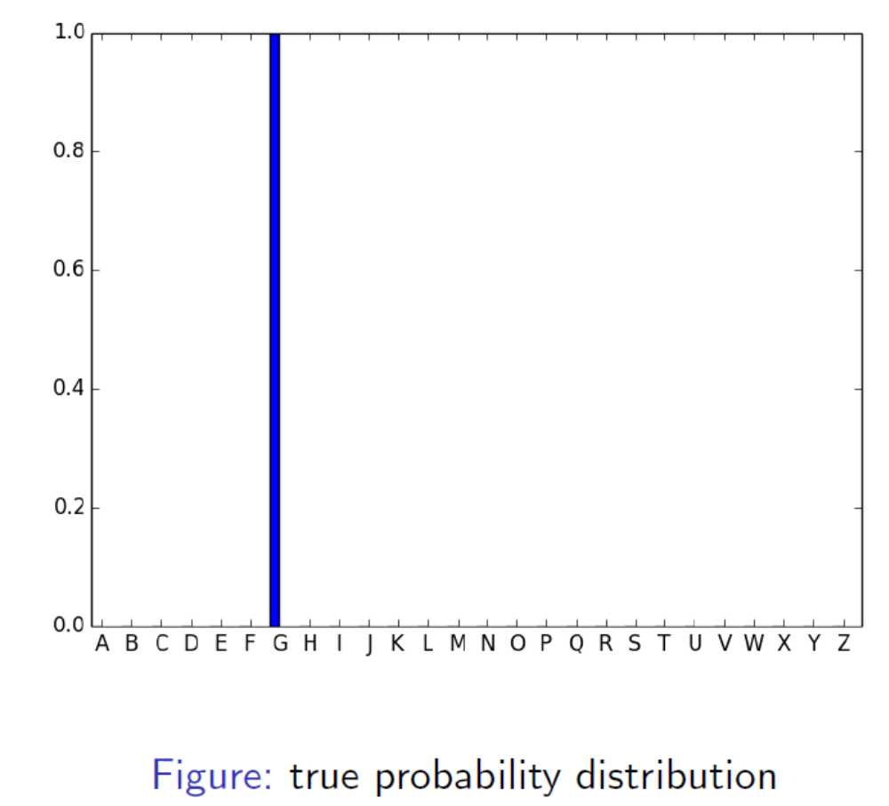

Slide 34
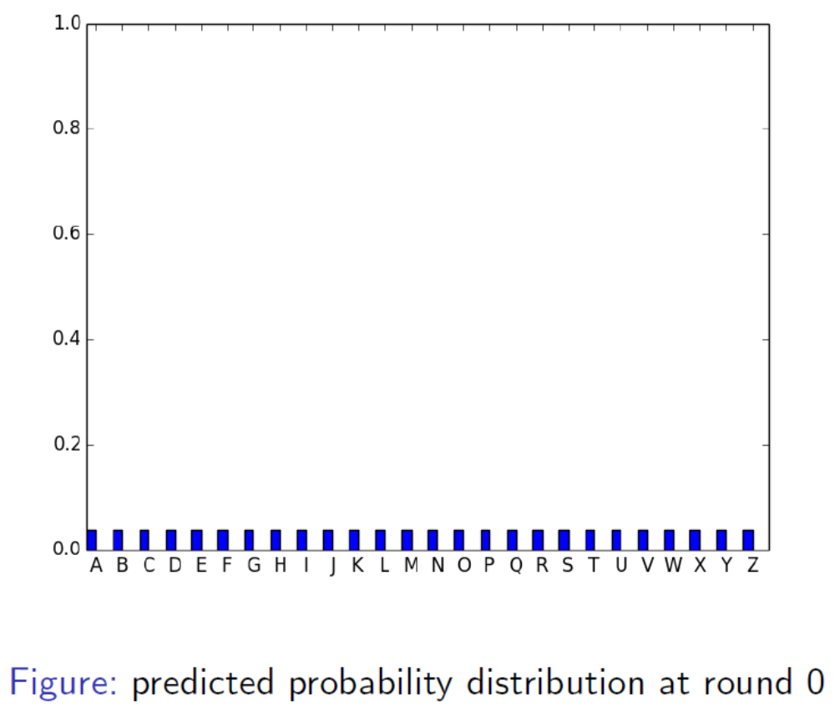

Slide 35
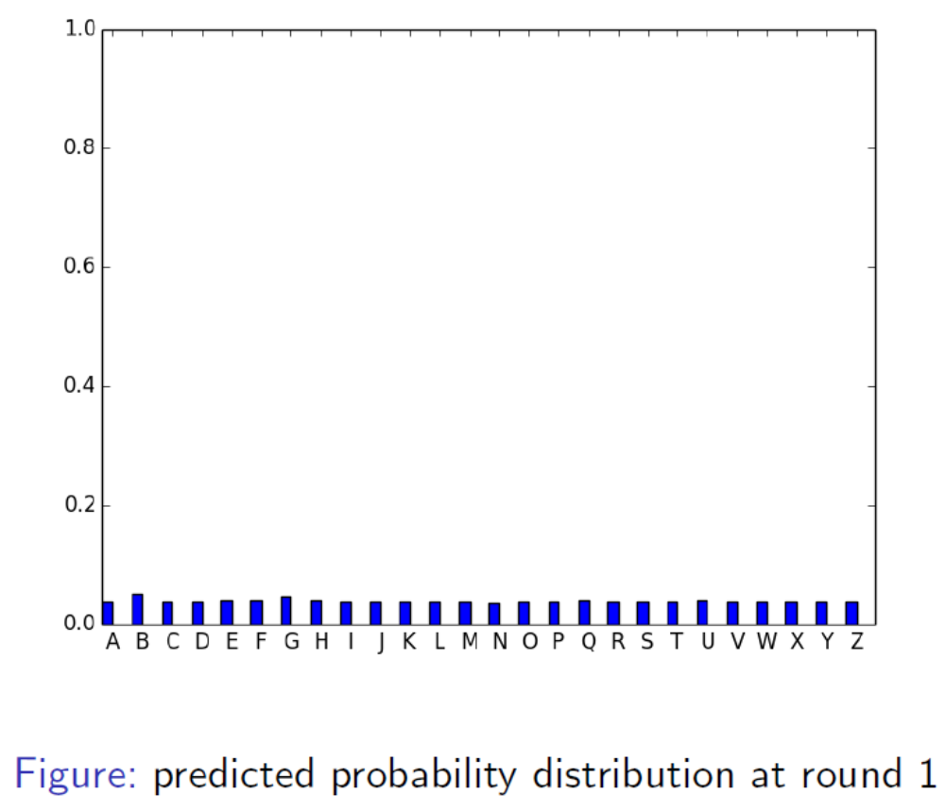

Slide 36
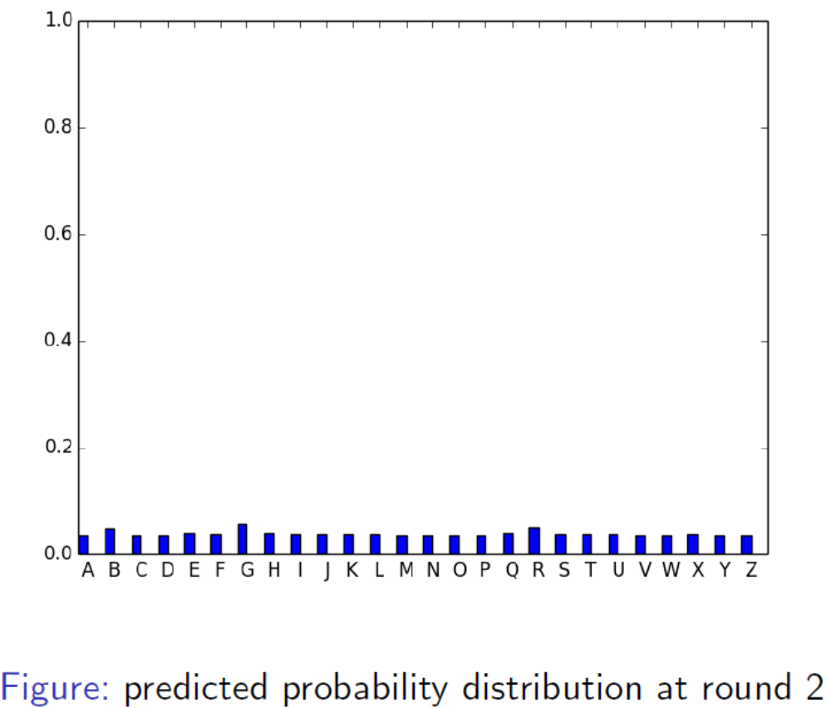

Slide 37
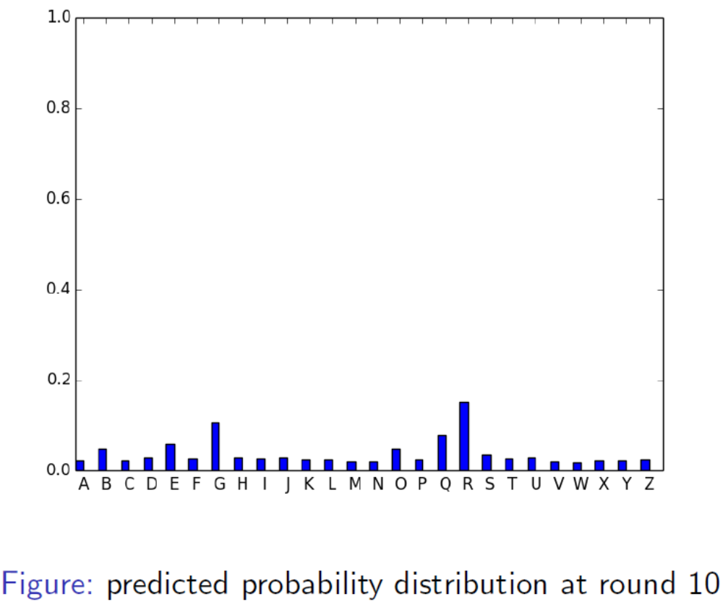

Slide 38
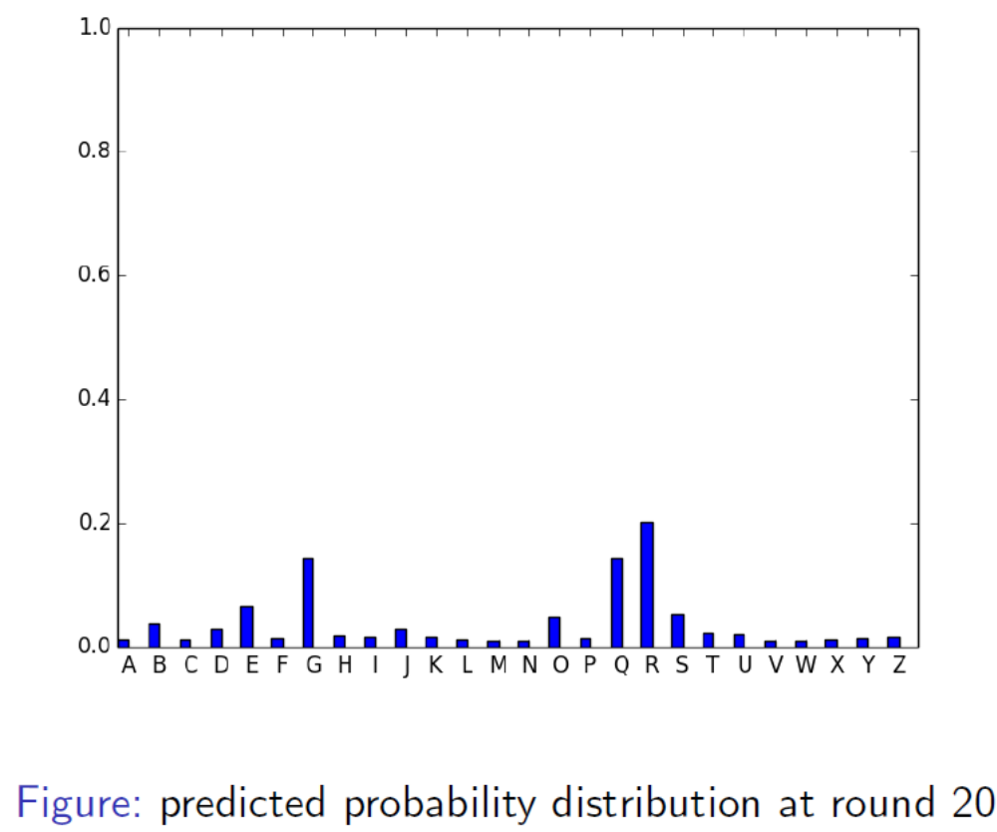

Slide 39
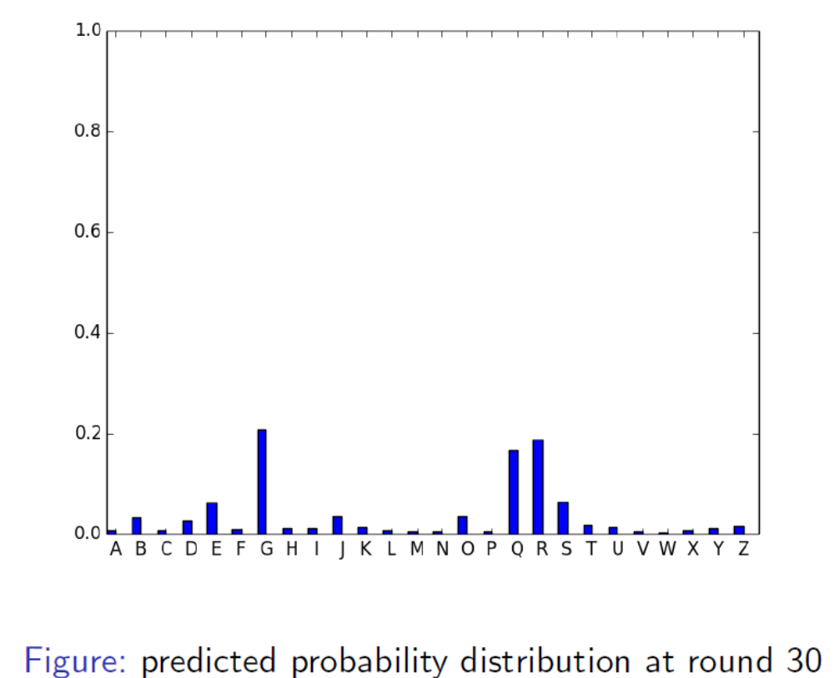

Slide 40
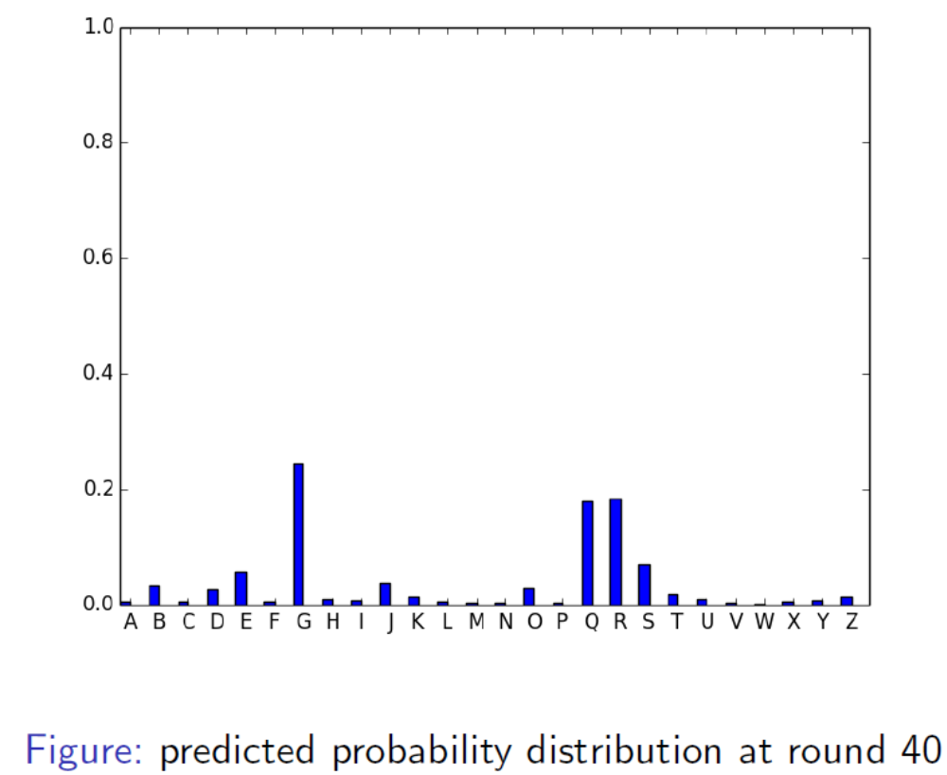

Slide 41
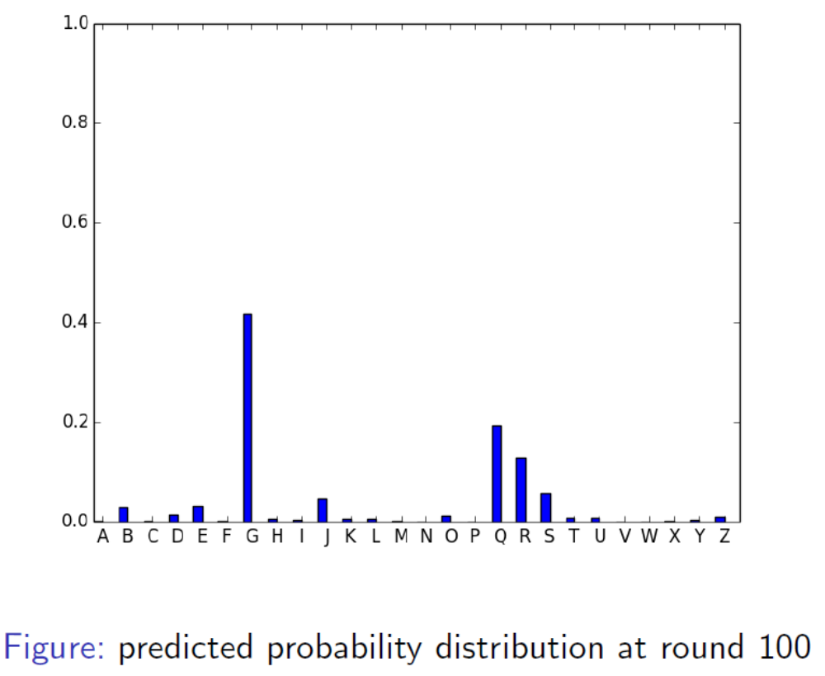

Slide 42
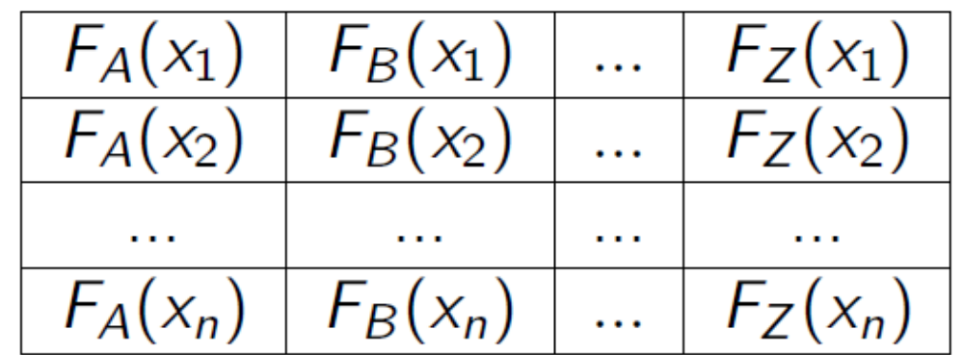
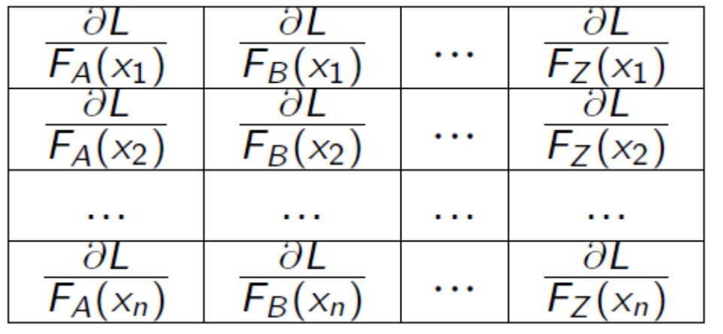
We achieve this goal by adjusting our models F_{A}, F_{B}, …, F_{Z} .
Differences
F_{A}, F_{B}, …, F_{Z} vs F
a matrix of parameters to optimize vs a column of parameters to optimize
a matrix of gradients vs a column of gradients

Slide 43
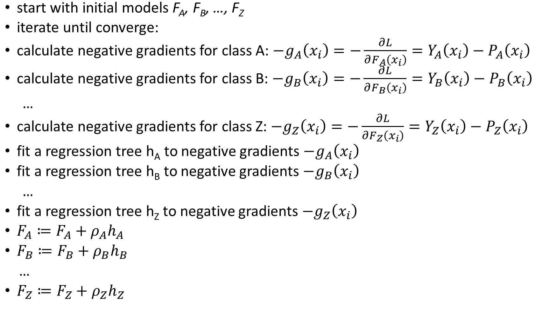

Slide 44
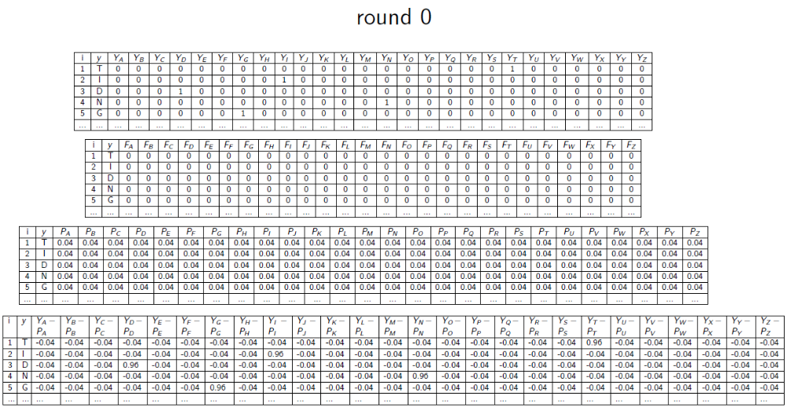

Slide 45
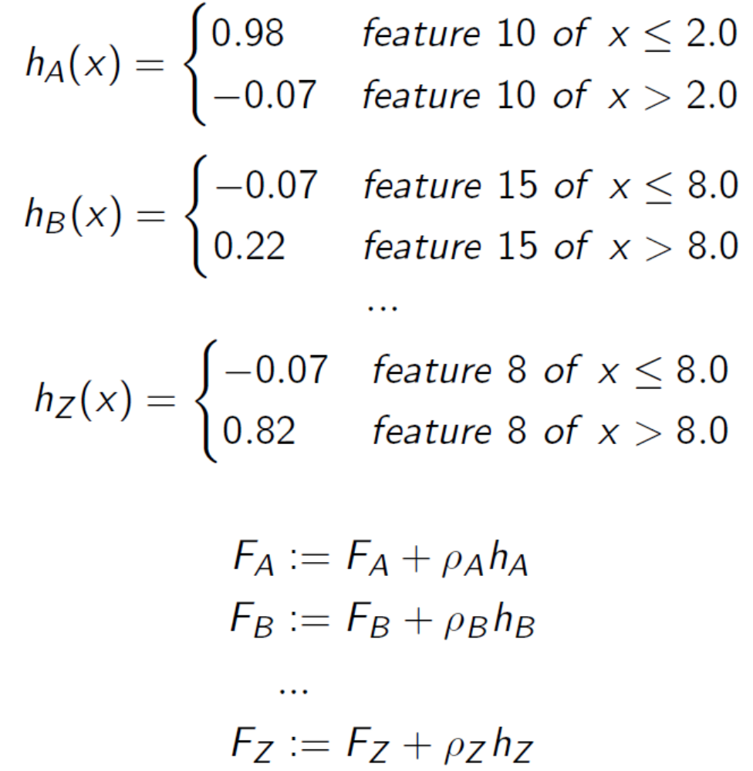

Slide 46
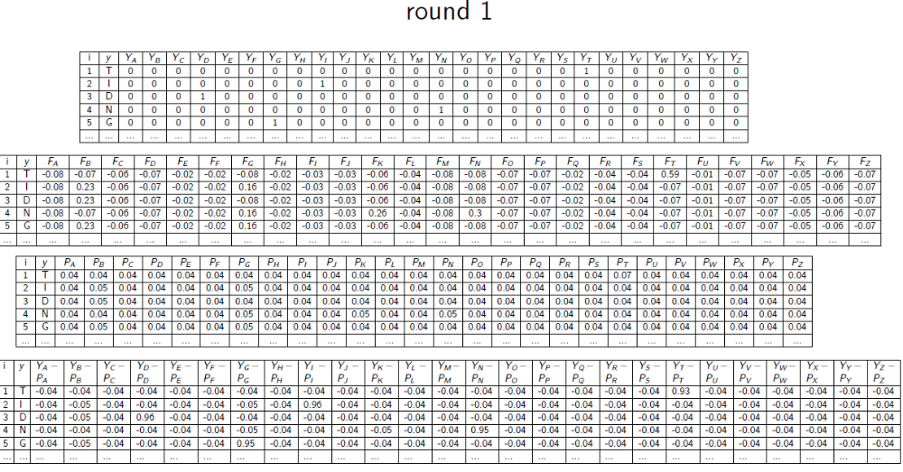

Slide 47
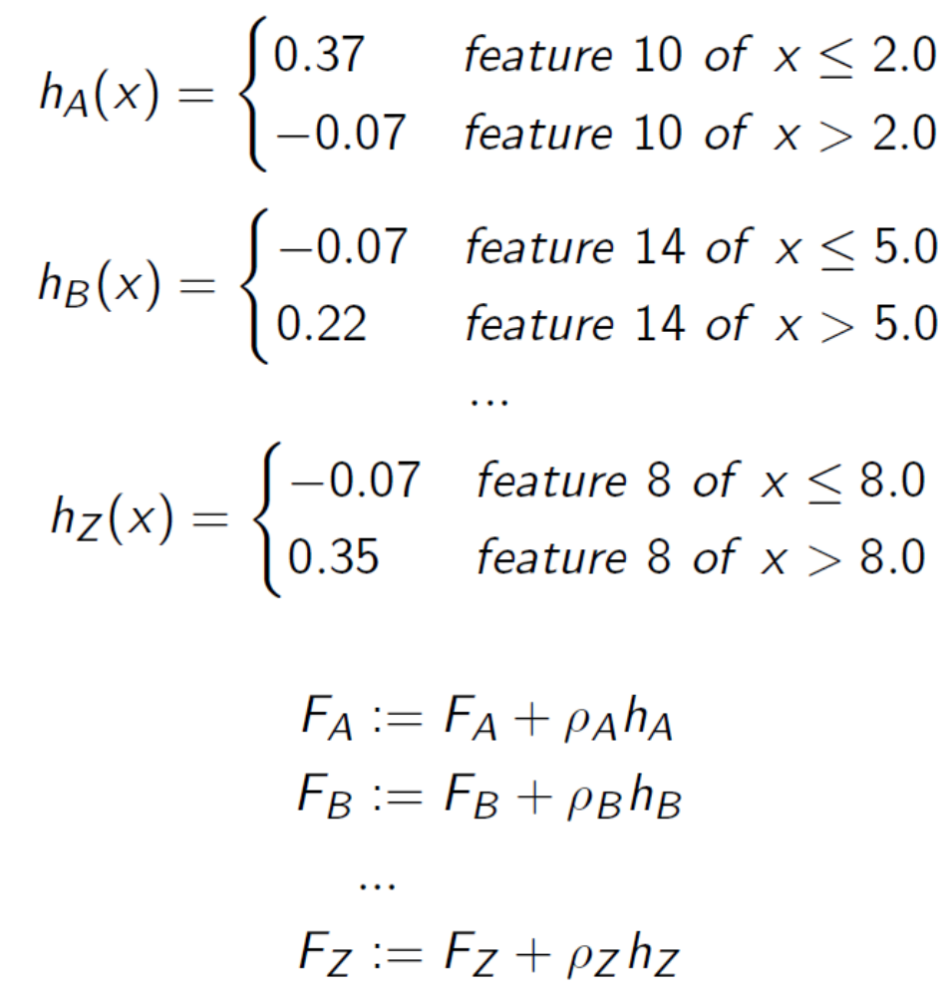

Slide 48
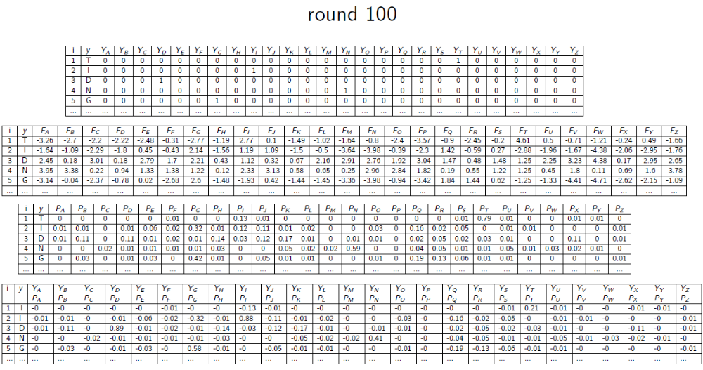

Slide 49
Bagging vs Boosting
No clear winner; usually depends on the data
Bagging is computationally more efficient than boosting (note that bagging can train the M models in parallel, boosting can’t)
Both reduce variance (and overfitting) by combining different models
The resulting model has higher stability as compared to the individual ones
Bagging usually can’t reduce the bias, boosting can (note that in boosting, the training error steadily decreases)
Bagging usually performs better than boosting if we don’t have a high bias and only want to reduce variance (i.e., if we are overfitting)

Slide 50
XGBoosting (Extreme Gradient Boosting)
Ever since its introduction in 2014, XGBoost has been lauded as the holy grail of machine learning hackathons and competitions. From predicting ad click-through rates to classifying high energy physics events, XGBoost has proved its mettle in terms of performance – and speed.
Execution Speed: Generally, XGBoost is fast. Really fast when compared to other implementations of gradient boosting. But newly introduced LightGBM is faster than XGBoosting.
Model Performance: XGBoost dominates structured or tabular datasets on classification and regression predictive modeling problems. The evidence is that it is the go-to algorithm for competition winners on the Kaggle competitive data science platform.

Slide 51
What Algorithm Does XGBoost Use?
The XGBoost library implements the gradient boosting decision tree algorithm.
This algorithm goes by lots of different names such as gradient boosting, multiple additive regression trees, stochastic gradient boosting or gradient boosting machines.
Boosting is an ensemble technique where new models are added to correct the errors made by existing models. Models are added sequentially until no further improvements can be made. A popular example is the AdaBoost algorithm that weights data points that are hard to predict.
Gradient boosting is an approach where new models are created that predict the residuals or errors of prior models and then added together to make the final prediction. It is called gradient boosting because it uses a gradient descent algorithm to minimize the loss when adding new models.
This approach supports both regression and classification predictive modeling problems.

Slide 52
Math Behind the Boosting Algorithms
In boosting, the trees are built sequentially such that each subsequent tree aims to reduce the errors of the previous tree. Each tree learns from its predecessors and updates the residual errors. Hence, the tree that grows next in the sequence will learn from an updated version of the residuals.
The base learners in boosting are weak learners in which the bias is high, and the predictive power is just a tad better than random guessing. Each of these weak learners contributes some vital information for prediction, enabling the boosting technique to produce a strong learner by effectively combining these weak learners. The final strong learner brings down both the bias and the variance.

Slide 53
Math Behind the Boosting Algorithms
In contrast to bagging techniques like Random Forest, in which trees are grown to their maximum extent, boosting makes use of trees with fewer splits.
Such small trees, which are not very deep, are highly interpretable. Parameters like the number of trees or iterations, the rate at which the gradient boosting learns, and the depth of the tree, could be optimally selected through validation techniques like k-fold cross validation.
Having a large number of trees might lead to overfitting. So, it is necessary to carefully choose the stopping criteria for boosting.

Slide 54


Math Behind the Boosting Algorithms
Boosting consists of three simple steps:
An initial model F₀ is defined to predict the target variable y. This model will be associated with a residual (y – F₀)
A new model h₁ is fit to the residuals from the previous step
Now, F₀ and h₁ are combined to give F₁, the boosted version of F₀. The mean squared error from F₁ will be lower than that from F₀:
To improve the performance of F₁, we could model after the residuals of F₁ and create a new model F₂:
This can be done for ‘m’ iterations, until residuals have been minimized as much as possible:
Here, the additive learners do not disturb the functions created in the previous steps. Instead, they impart information of their own to bring down the errors.

Slide 55
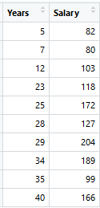
Demonstrating the Potential of Boosting
Consider the following data where the years of experience is predictor variable and salary (in thousand dollars) is the target. Using regression trees as base learners, we can create a model to predict the salary. For the sake of simplicity, we can choose square loss as our loss function and our objective would be to minimize the square error.

Slide 56

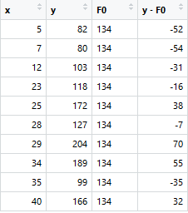
As the first step, the model should be initialized with a function F₀(x). F₀(x) should be a function which minimizes the loss function or MSE (mean squared error).
Taking the first differential of the above equation with respect to y, it is seen that the function minimizes at the mean. So, the boosting model could be initiated with:
F₀(x) gives the predictions from the first stage of our model. Now, the residual error for each instance is (y_{i} – F₀(x)).

Slide 57
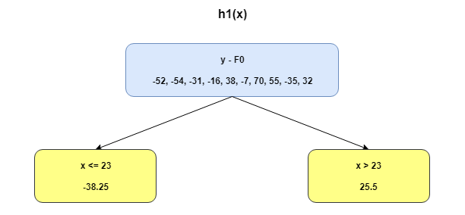
We can use the residuals from F₀(x) to create h₁(x). h₁(x) will be a regression tree which will try and reduce the residuals from the previous step. The output of h₁(x) won’t be a prediction of y; instead, it will help in predicting the successive function F₁(x) which will bring down the residuals.

Slide 58
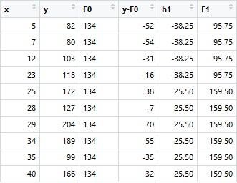
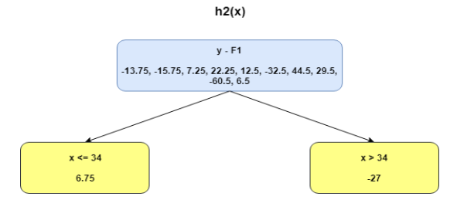
The additive model h₁(x) computes the mean of the residuals (y – F₀) at each leaf of the tree. The boosted function F₁(x) is obtained by summing F₀(x) and h₁(x). This way h₁(x) learns from the residuals of F₀(x) and suppresses it in F₁(x).

Slide 59
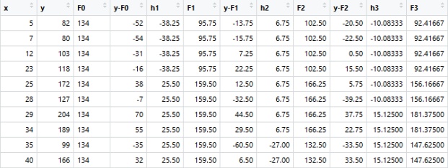
The MSEs for F₀(x), F₁(x) and F₂(x) are 875, 692 and 540. It’s amazing how these simple weak learners can bring about a huge reduction in error!
Note that each learner, h_{m}(x), is trained on the residuals. All the additive learners in boosting are modeled after the residual errors at each step. Intuitively, it could be observed that the boosting learners make use of the patterns in residual errors. At the stage where maximum accuracy is reached by boosting, the residuals appear to be randomly distributed without any pattern.

Slide 60
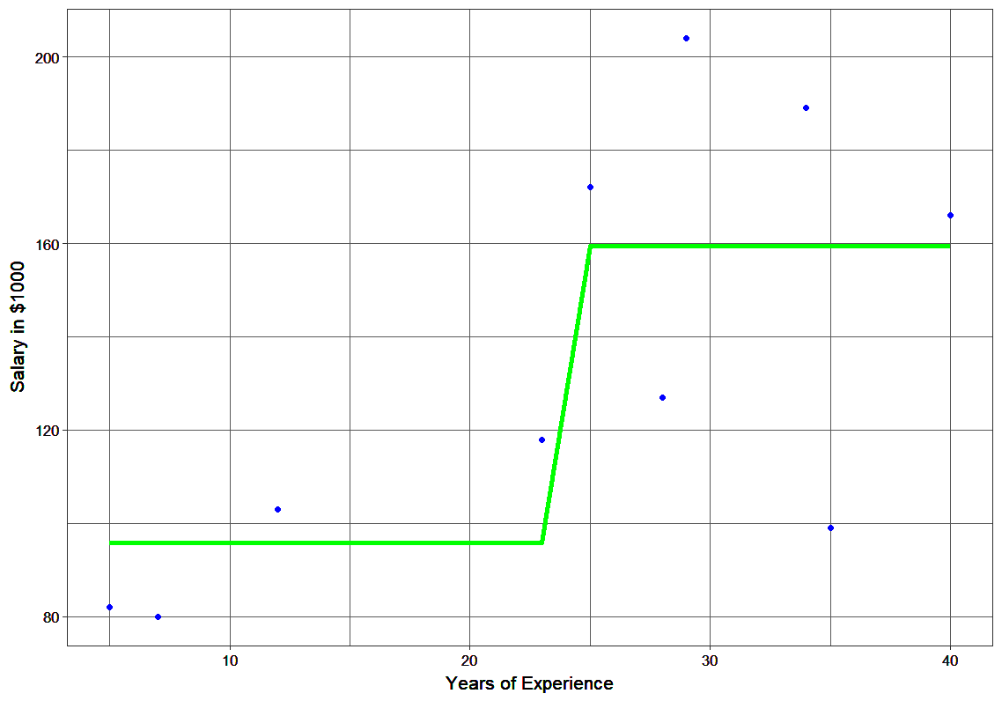
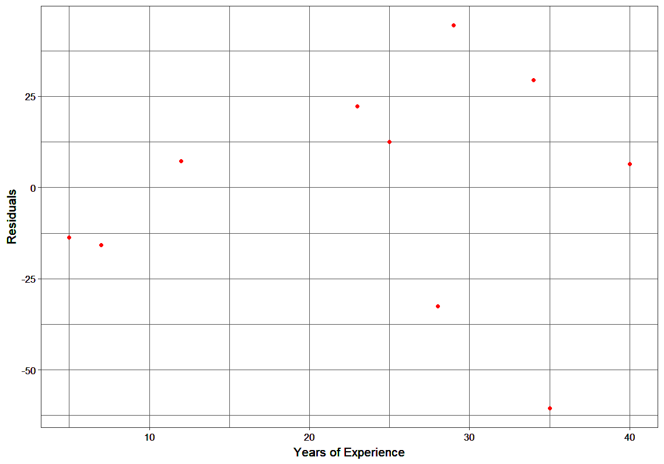
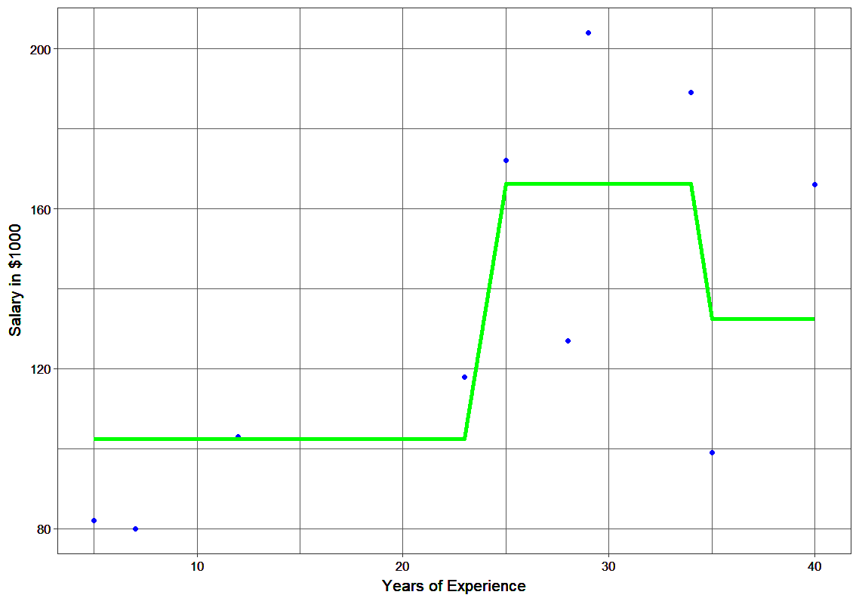
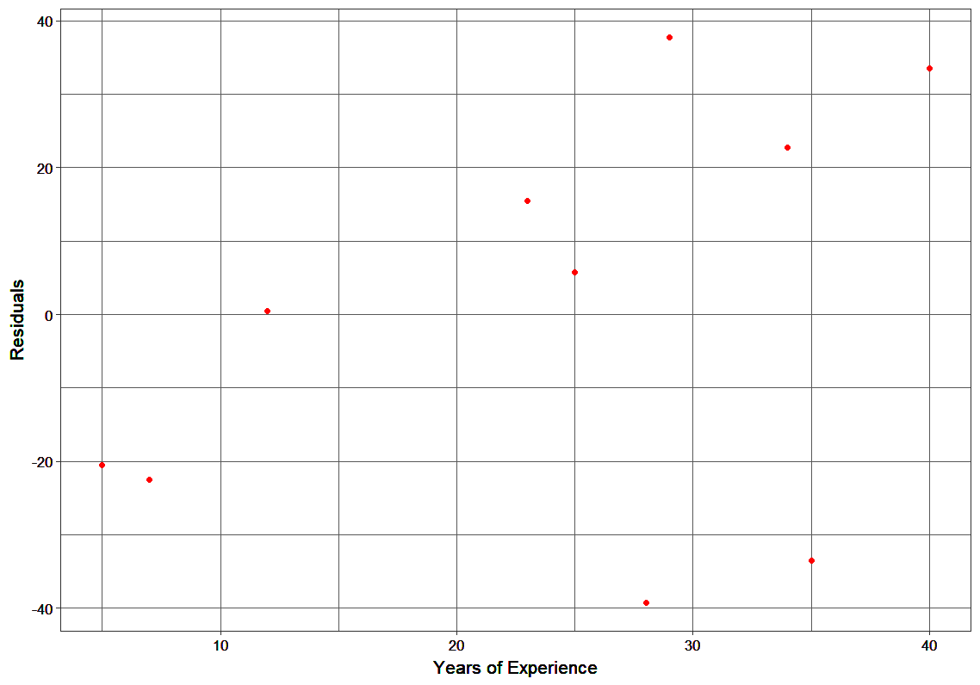
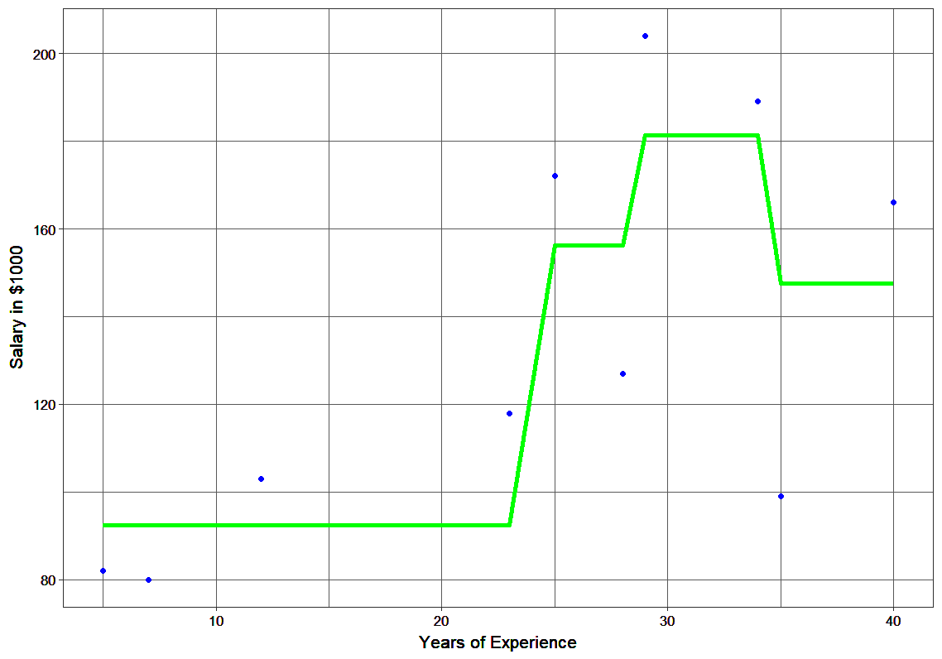
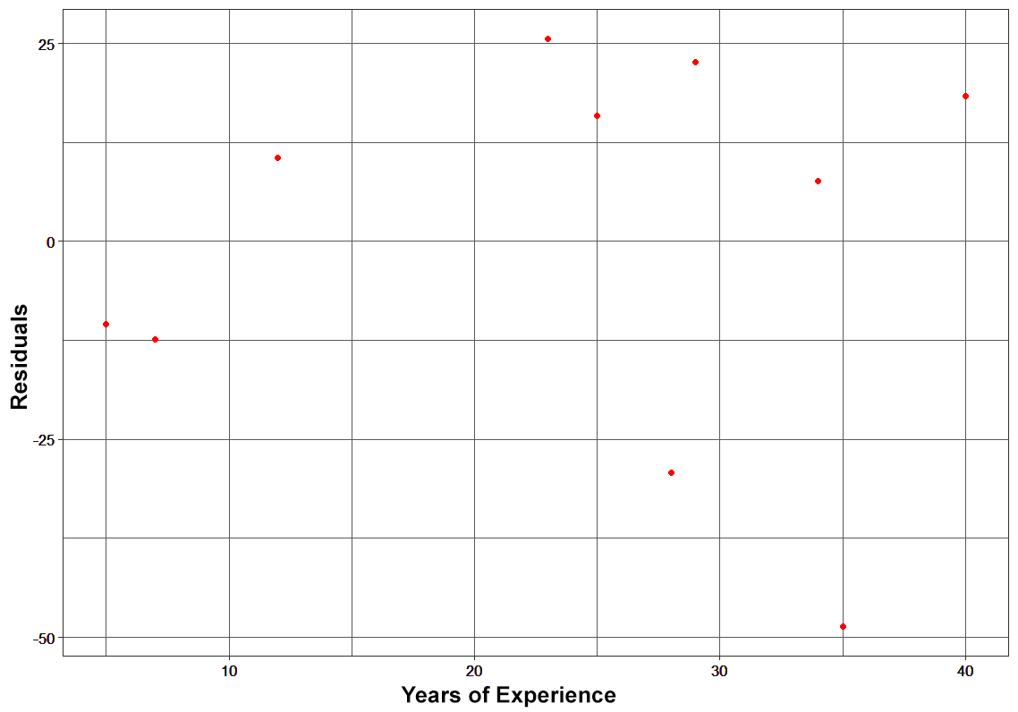

Slide 61
XGBoosting (Extreme Gradient Boosting)
What is the difference between the R gbm (gradient boosting machine) and XGBoost (extreme gradient boosting)?
Both XGBoost and gbm follows the principle of gradient boosting. There are however, the difference in modeling details. Specifically, XGBoost used a more regularized model formalization to control over-fitting, which gives it better performance.
Objective Function : Training Loss + Regularization
The regularization term controls the complexity of the model, which helps us to avoid overfitting. This sounds a bit abstract, so let us consider the following problem in the following picture. You are asked to fit visually a step function given the input data points on the upper left corner of the image. Which solution among the three do you think is the best fit?

Slide 62
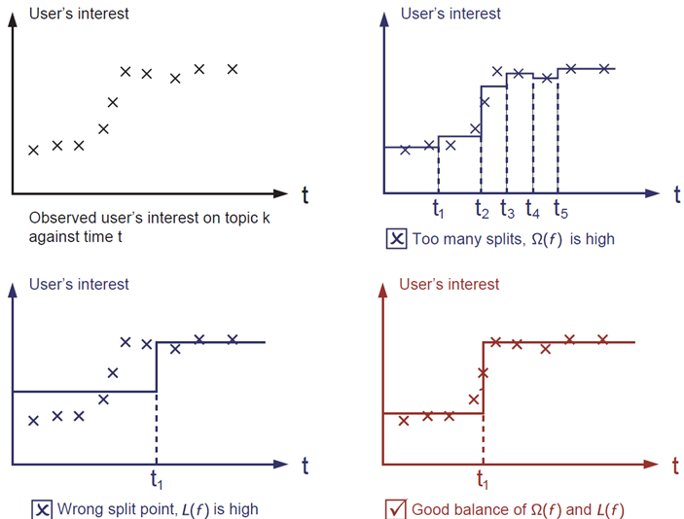

Slide 63
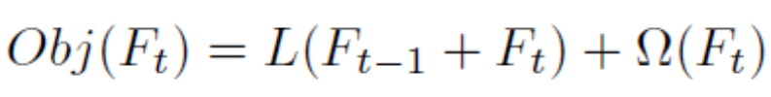
XGBoosting
In the XGBoost package, at the t^{th} step we are tasked with finding the tree F_{t} that will minimize the following objective function:
where L(F_{t}) is our loss function and Ω(F_{t}) is our regularization function.
Regularization is essential to prevent overfitting to the training set. Without any regularization, the tree will split until it can predict the training set perfectly. This will usually mean that the tree has lost generality and will not do well on new test data. In XGBoost, the regularization function shows the model complexity.

Slide 64
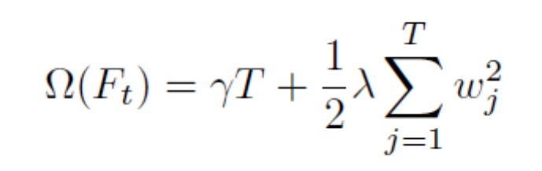
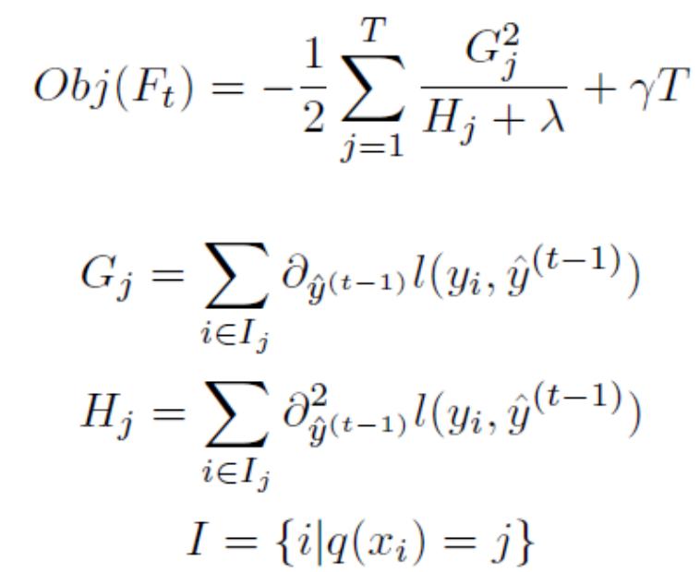
where T is the number of leaves in the tree, w_{j} is the score of leaf j, γ is the leaf weight penalty parameter, and λ is the tree size penalty parameter.
Determining how to find the function to optimize the above objective function is not clear.
where q(x) maps input features to a leaf node in the tree and l(y_{i}; y^) is our loss function. This objective function is much easier to work with because it is now gives a score that we can use to determine how good a tree structure is.

Slide 65
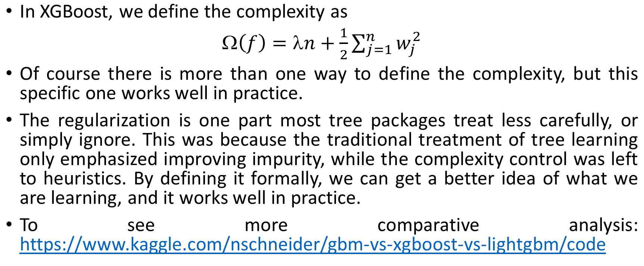
Model Complexity

Slide 66
Unique features of XGBoost
XGBoost is a popular implementation of gradient boosting. Let’s discuss some features of XGBoost that make it so interesting.
Regularization: XGBoost has an option to penalize complex models through both L1 and L2 regularization. Regularization helps in preventing overfitting
Handling sparse data: Missing values or data processing steps like one-hot encoding make data sparse. XGBoost incorporates a sparsity-aware split finding algorithm to handle different types of sparsity patterns in the data
Weighted quantile sketch: Most existing tree based algorithms can find the split points when the data points are of equal weights (using quantile sketch algorithm). However, they are not equipped to handle weighted data. XGBoost has a distributed weighted quantile sketch algorithm to effectively handle weighted data

Slide 67
Unique features of XGBoost
Block structure for parallel learning: For faster computing, XGBoost can make use of multiple cores on the CPU. This is possible because of a block structure in its system design. Data is sorted and stored in in-memory units called blocks. Unlike other algorithms, this enables the data layout to be reused by subsequent iterations, instead of computing it again. This feature also serves useful for steps like split finding and column sub-sampling
Cache awareness: In XGBoost, non-continuous memory access is required to get the gradient statistics by row index. Hence, XGBoost has been designed to make optimal use of hardware. This is done by allocating internal buffers in each thread, where the gradient statistics can be stored
Out-of-core computing: This feature optimizes the available disk space and maximizes its usage when handling huge datasets that do not fit into memory

Slide 68
Parameters
XGBoost requires a number of parameters to be selected. The following is a list of all the parameters that can be specified:
(eta) Shrinkage term. Each new tree that is added has its weight shrunk by this parameter, preventing overfitting, but at the cost of increasing the number of rounds needed for convergence.
(gamma) Tree size penalty
max depth The maximum depth of each tree
min child weight The minimum weight that a node can have. If this minimum is not met, that particular split will not occur.
subsample Gives us the opportunity to perform "bagging,“ which means randomly sampling with replacement a proportion specified by parameter of the training examples to train each round on. The value is between 0 and 1 and is a method that helps prevent overfitting.
colsample bytree Allows us to perform "feature bagging,“ which picks a proportion of the features to build each tree with. This is another way of preventing overfitting.
(lambda) This is the L2 leaf node weight penalty

Slide 69
R Example (http://www.sthda.com/english/articles/35-statistical-machine-learning-essentials/139-gradient-boosting-essentials-in-r-using-xgboost/ )
Boosting has different tuning parameters including:
  The number of trees B
  The shrinkage parameter lambda
  The number of splits in each tree.
There are different variants of boosting, including Adaboost, gradient boosting and stochastic gradient boosting.
Stochastic gradient boosting, implemented in the R package xgboost, is the most commonly used boosting technique, which involves resampling of observations and columns in each round. It offers the best performance. xgboost stands for extremely gradient boosting.
Boosting can be used for both classification and regression problems.
We’ll see how to compute boosting in R

Slide 70
Loading required R packages
tidyverse for easy data manipulation and visualization
caret for easy machine learning workflow
xgboost for computing boosting algorithm

Slide 71
Classification
Data set: PimaIndiansDiabetes2 [in mlbench package], for predicting the probability of being diabetes positive based on multiple clinical variables.
Randomly split the data into training set (80% for building a predictive model) and test set (20% for evaluating the model). Make sure to set seed for reproducibility.
library(tidyverse)
library(caret)
library(xgboost)
library(mlbench)
library(dplyr)
# Load the data and remove NAs
data("PimaIndiansDiabetes2", package = "mlbench")
PimaIndiansDiabetes2 <- na.omit(PimaIndiansDiabetes2)
set.seed(123)
# Split the data into training and test set
training.samples <- PimaIndiansDiabetes2$diabetes %>% createDataPartition(p = 0.8, list = FALSE)
train.data <- PimaIndiansDiabetes2[training.samples, ]
test.data <- PimaIndiansDiabetes2[-training.samples, ]

Slide 72
summary(PimaIndiansDiabetes2)
pregnant glucose pressure triceps
Min. : 0.000 Min. : 56.0 Min. : 24.00 Min. : 7.00
1st Qu.: 1.000 1st Qu.: 99.0 1st Qu.: 62.00 1st Qu.:21.00
Median : 2.000 Median :119.0 Median : 70.00 Median :29.00
Mean : 3.301 Mean :122.6 Mean : 70.66 Mean :29.15
3rd Qu.: 5.000 3rd Qu.:143.0 3rd Qu.: 78.00 3rd Qu.:37.00
Max. :17.000 Max. :198.0 Max. :110.00 Max. :63.00
insulin mass pedigree age diabetes
Min. : 14.00 Min. :18.20 Min. :0.0850 Min. :21.00 neg:262
1st Qu.: 76.75 1st Qu.:28.40 1st Qu.:0.2697 1st Qu.:23.00 pos:130
Median :125.50 Median :33.20 Median :0.4495 Median :27.00
Mean :156.06 Mean :33.09 Mean :0.5230 Mean :30.86
3rd Qu.:190.00 3rd Qu.:37.10 3rd Qu.:0.6870 3rd Qu.:36.00
Max. :846.00 Max. :67.10 Max. :2.4200 Max. :81.00
# Inspect the data
sample_n(PimaIndiansDiabetes2, 3)
pregnant glucose pressure triceps insulin mass pedigree age diabetes
232 6 134 80 37 370 46.2 0.238 46 pos
600 1 109 38 18 120 23.1 0.407 26 neg
319 3 115 66 39 140 38.1 0.150 28 neg

Slide 73
Boosted classification trees
We’ll use the caret workflow, which invokes the xgboost package, to automatically adjust the model parameter values, and fit the final best boosted tree that explains the best our data.
We’ll use the following arguments in the function train():
trControl, to set up 10-fold cross validation
# Fit the model on the training set
set.seed(123)
model <- train(
diabetes ~., data = train.data, method = "xgbTree",
trControl = trainControl("cv", number = 10)
)
# Best tuning parameter
model$bestTune
nrounds max_depth eta gamma colsample_bytree min_child_weight subsample
22 50 2 0.3 0 0.6 1 0.75

Slide 74
# Make predictions on the test data
predicted.classes <- model %>% predict(test.data) head(predicted.classes)
[1] neg pos neg pos pos neg
Levels: neg pos
# Compute model prediction accuracy rate
mean(predicted.classes == test.data$diabetes)
[1] 0.7820513

Slide 75
Variable importance
The function varImp() [in caret] displays the importance of variables in percentage:
varImp(model)
xgbTree variable importance
Overall
glucose 100.000
age 22.280
insulin 15.511
mass 15.066
pedigree 6.566
pregnant 5.176
pressure 1.439
triceps 0.000

Slide 76
Regression
Similarly, you can build a random forest model to perform regression, that is to predict a continuous variable.
Example of data set
We’ll use the Boston data set [in MASS package], for predicting the median house value (mdev), in Boston Suburbs, using different predictor variables.
Randomly split the data into training set (80% for building a predictive model) and test set (20% for evaluating the model).
library(MASS)
# Load the data
data("Boston", package = "MASS")
# Inspect the data
sample_n(Boston, 3)
# Split the data into training and test set
set.seed(123)
training.samples <- Boston$medv %>% createDataPartition(p = 0.8, list = FALSE)
train.data <- Boston[training.samples, ]
test.data <- Boston[-training.samples, ]

Slide 77
Boosted regression trees
Here the prediction error is measured by the RMSE, which corresponds to the average difference between the observed known values of the outcome and the predicted value by the model.
# Fit the model on the training set
set.seed(123)
model <- train(
medv ~., data = train.data, method = "xgbTree",
trControl = trainControl("cv", number = 10) )
# Best tuning parameter mtry
model$bestTune
nrounds max_depth eta gamma colsample_bytree min_child_weight subsample
24 150 2 0.3 0 0.6 1 0.75
# Make predictions on the test data
predictions <- model %>% predict(test.data)
head(predictions)
[1] 34.57916 34.52773 19.75562 21.84306 20.38543 18.97059
# Compute the average prediction error RMSE
RMSE(predictions, test.data$medv)
[1] 2.838189 #MSE=8.055315

Slide 78
For another examples,
https://www.kaggle.com/camnugent/gradient-boosting-and-parameter-tuning-in-r/code
https://rstudio-pubs-static.s3.amazonaws.com/64455_df98186f15a64e0ba37177de8b4191fa.html

Slide 79
Some References
Friedman, J., Hastie, T., and Tibshirani, R. (2000). Special invited paper. additive logistic regression: A statistical view of boosting. Annals of statistics, pages 337-374.
Friedman, J. H. (2001). Greedy function approximation: a gradient boosting machine. Annals of Statistics, pages 1189-1232.
Schapire, R. E. and Freund, Y. (2012). Boosting: Foundations and Algorithms. MIT Press.
James, Gareth, Daniela Witten, Trevor Hastie, and Robert Tibshirani. 2014. An Introduction to Statistical Learning: With Applications in R. Springer Publishing Company, Incorporated.

